Slide 1
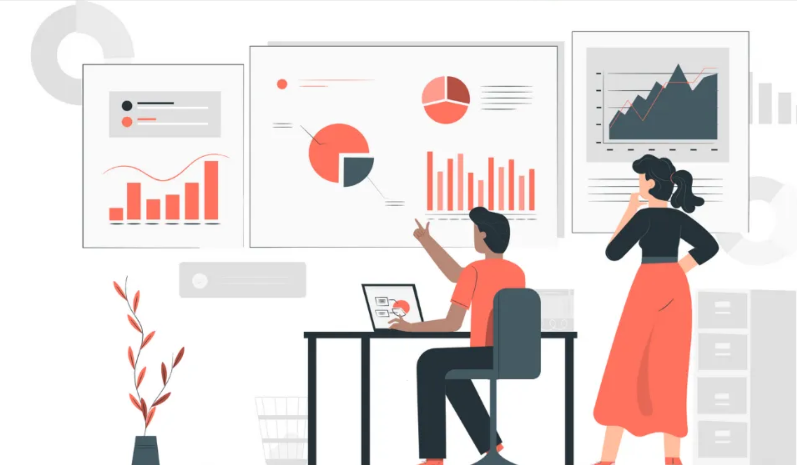
Dharmik Patel - 0813537
Title: WALMART RETAIL – DATA ANALYSIS (Customer Behavior Analysis)

Slide 2

INTRODUCTION AND DATA OVERVIEW
Walmart is a global retail, that constantly struggles to remain ahead of the constantly changing industry
The dataset provides a comprehensive picture of the retail industry, including order details, product information, financial metrics, and consumer attributes like age, name, and segment.
Dataset Link : https://data.world/ahmedmnif150/walmart-retail-dataset/workspace/file?filename=Walmart-Retail-Dataset.csv Data in (Trillion )

Slide 3

Business Objectives
Objective: Utilize RFM (Recency, Frequency, Monetary Value) analysis on Walmart data.
Goal : Divide customers into segments to identify potential customer groups, enabling the design of targeted and profitable marketing strategies.

Slide 4

Marketing Problem Research:
Identify Important Customer Segments: Use customer demographic analysis to pinpoint high-value customer groups that make a substantial contribution to revenue and profit.
Optimize Discount techniques: To suggest efficient discounting techniques, assess how discounts affect order quantity, sales, and profit.
Improve the Selection of Products : To help with inventory optimization, identify the most profitable product categories and subcategories.
Geographical Analysis: Analyze geographical differences in consumer behavior using geographic analysis to adjust marketing tactics to suit local tastes.

Slide 5
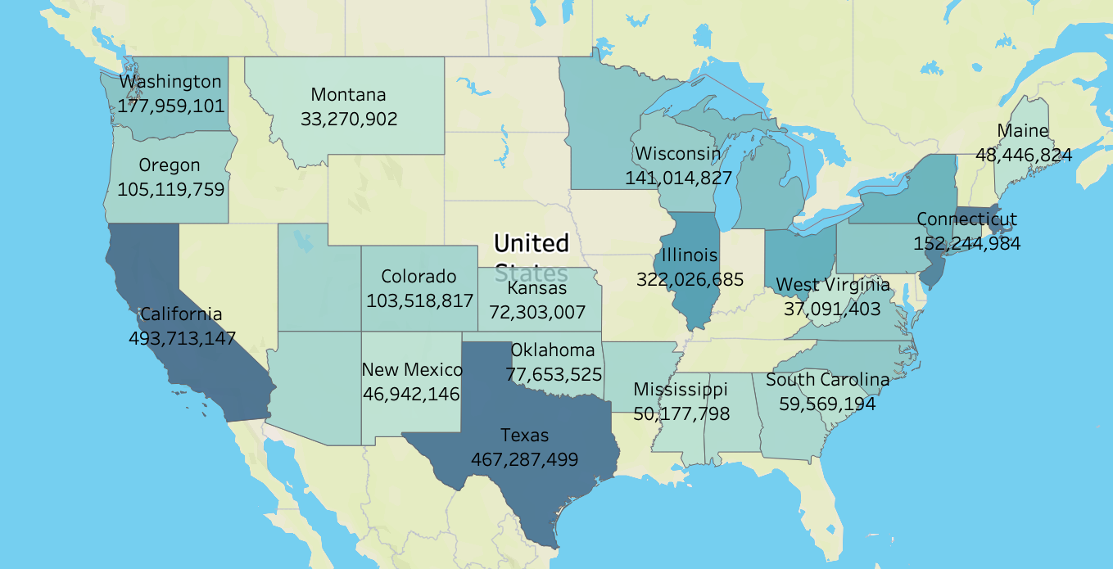
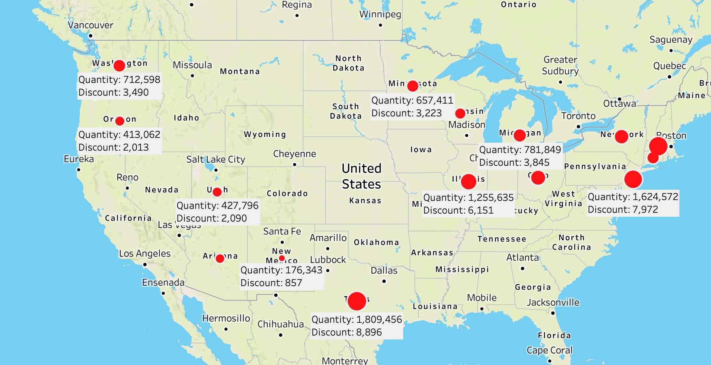
Insights :
California and Texas make more money than the other two states combined, and Texas also offers more discounts.
Recommendations:
Examine Texas's offerings and make an effort to provide similar offers to other states. The customer satisfaction ratio will rise, and you can establish a reward card point system similar to what's available today. Customers at Fresco receive points through the Scene+ point system.

Slide 6
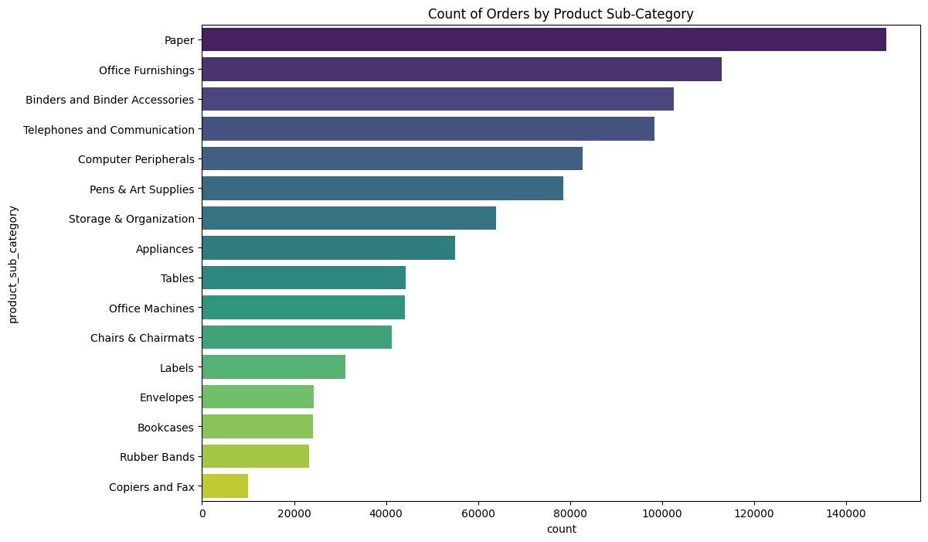
Insights :
In the United States, office supplies and paper are the most popular products. The least popular items, however, are copier and fax machines, rubber bands, and bookcases.
Recommendations:
increased focus on product quality and advertisement if necessary to replace bookcases, rubber bands, and fax machines of higher quality.
Give them further discounts and send them emails with fresh deals.
In order to motivate clients to make purchases, include discounts and promotions into the recommendation system.
Take into account customized advertising depending on certain client or lifestyle.

Slide 7
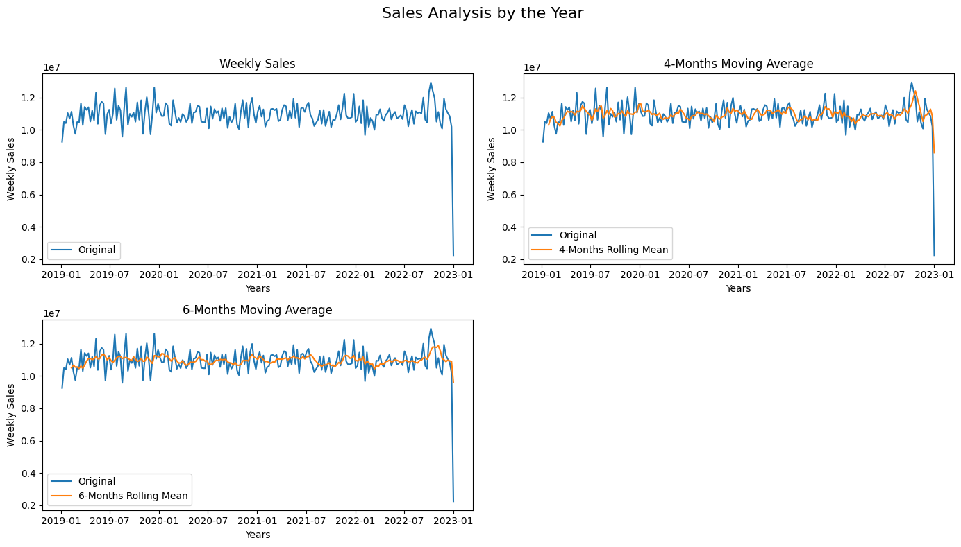
Insights:
After four months, sales fluctuate slightly less than they did initially between 100,000 and 120,000 and after six months, sales increase after 2022–07.
Recommendations:
Examine the initial weekly sales plot to find any obvious patterns, seasonality, or trends. It is essential to comprehend these trends in order to make wise business judgments.
Weekly sales are probably going to be the same after four or six months, therefore businesses need to concentrate more on deals and work to increase sales every day by promoting new products, making discounts, and educating clients about products.

Slide 8
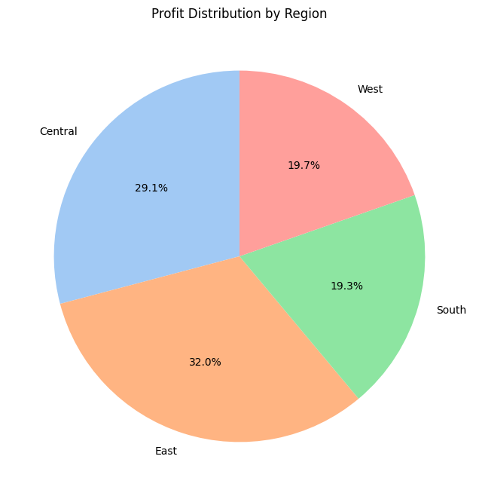
Insights:
While the west and south have a low profit, the east region has a higher profit rate than the other regions.
Recommendations:
Implement retention strategies and customer satisfaction enhancements across all areas to maintain the high Profit rates.
Determine different client segments according to their tastes, demographics, and purchase patterns.
Make purchasing online as well as in person as efficient, enjoyable, and user-friendly as possible.

Slide 9
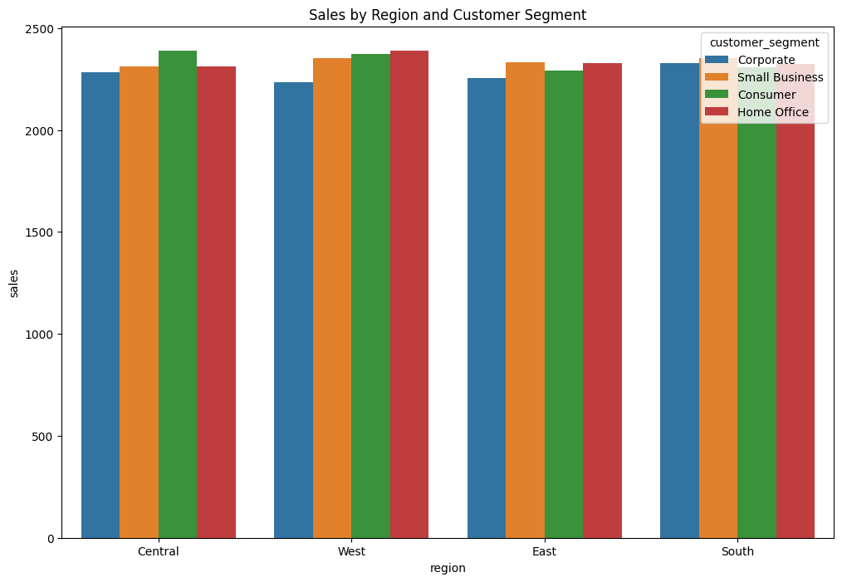
Insights:
While consumer sales are higher in the Central Region, small business products are more popular in the West. Additionally, every region is the same for homes and offices.
Recommendations:
Establish the corporate segment's retention tactics for both East and West.

Slide 10

RFM Analysis
RFM Analysis is a marketing framework that is used to understand and analyze customer behavior based on the above three factors RECENCY, Frequency, and Monetary.
The RFM Analysis will help the businesses to segment their customer base into different homogenous groups so that they can engage with each group with different targeted marketing strategies.

Slide 11
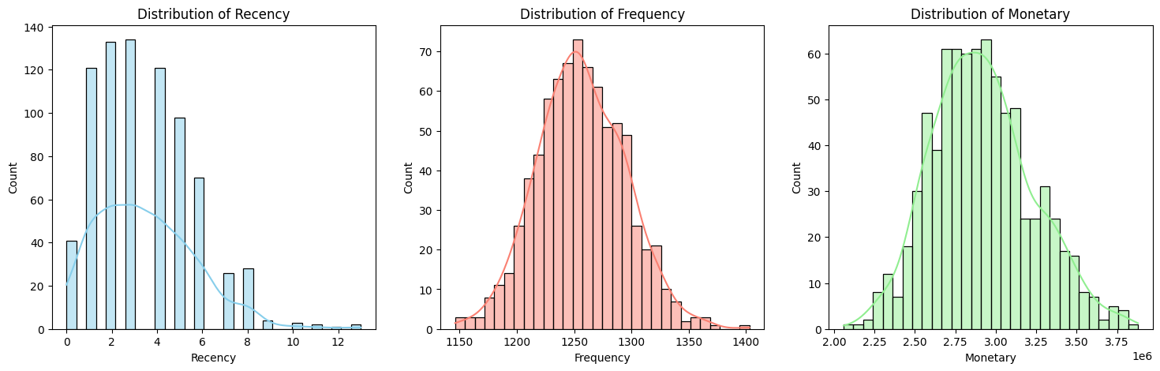
Analysis :
customers are divided into three categories based on the Recency, Frequency, and Monetary determined RFM score: those who are at risk, those who are our top customers, and those who require attention so that we can track changes in their behavior of the customers.
Recommendations:
Observe how RFM measurements change with the seasons or in reaction to special offers or occasions.
Make the most of these information to enhance product offerings and marketing timing.

Slide 12
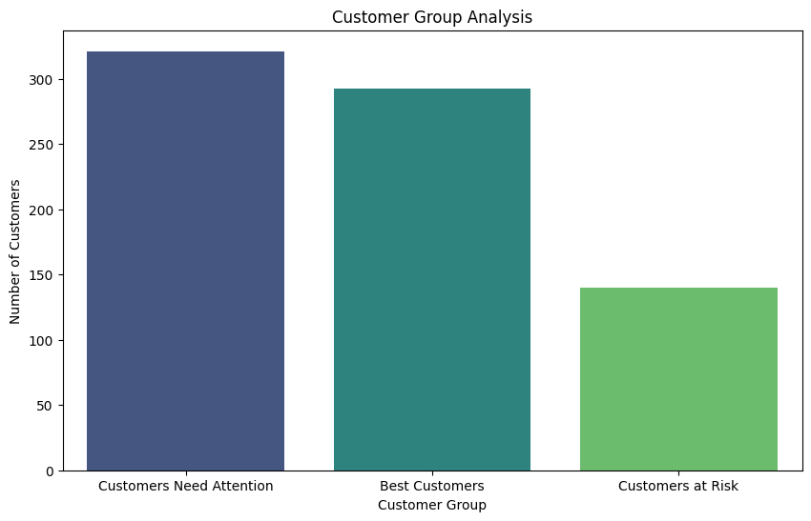
Insights:
Customers at risk have a lower RFM score opposed to top customers, who have a higher RFM score.
Recommendations:
Identify and address specific issues unique to each for the group to improve Profit.
Implement retention strategies and customer satisfaction enhancements across all areas to/maintain the high non-churn rates and potentially reduce churn even further.

Slide 13
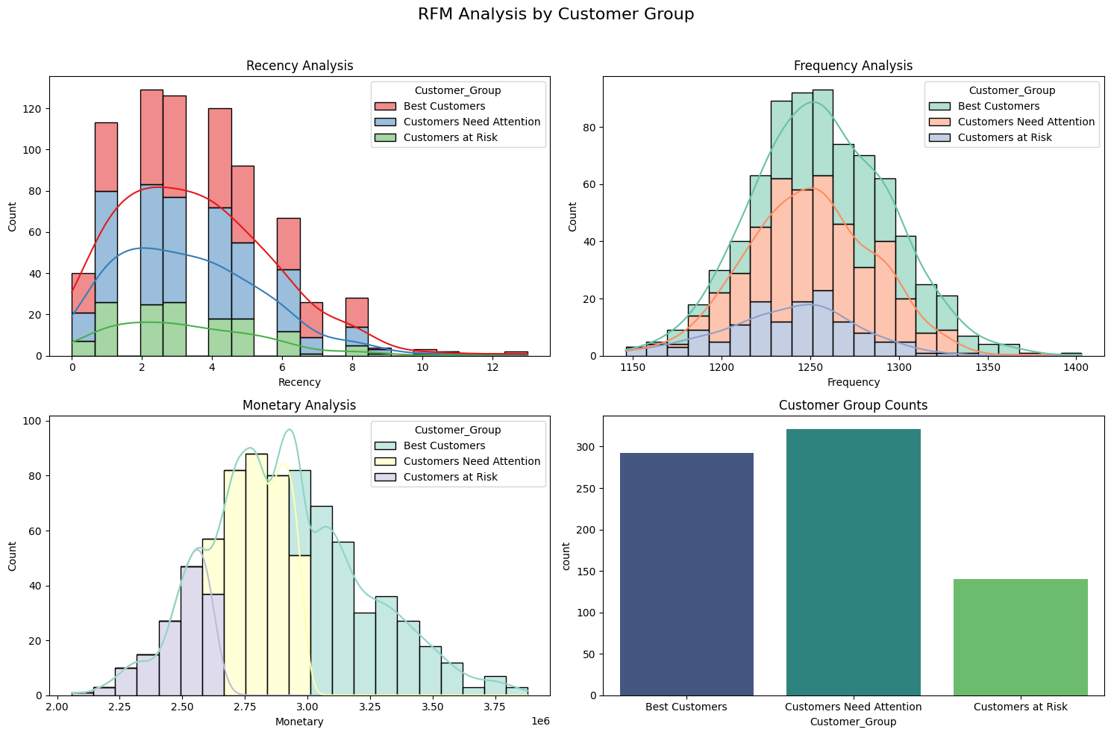
Insights:
The graph indicates that the most profitable consumers have higher frequency and higher amounts. However, customers need Attention that group spending likely same amount of money though they have less frequency and Recency for buying products
Recommendations:
Create specialized marketing campaigns with the "Customers Need Attention" group in mind.
Provide exclusive discounts, time-limited deals, or loyalty benefits to encourage more frequent purchases.
Send out newsletters, SMS alerts, or targeted email campaigns to inform them of updates, new items, or discounts.
Gather information through surveys or feedback forms, then modify your services to match their needs.

Slide 14

Why use RFM Analysis?
Adjustments in RFM assessments may signify modifications in consumer preferences, satisfaction, or market conditions.
identifies various customer segments with unique buying habits.
makes it possible to implement focused strategies to keep and grow revenue from valuable consumers.
increases conversion rates and consumer engagement with customized premonition .

Slide 15

Final Thoughts
Customer behavior analysis is a crucial aspect of business strategy in the modern age. It helps companies gain insights into their customers' preferences, needs, and habits. By leveraging data and advanced analytics, businesses can tailor their offerings, improve customer experiences, and drive growth.
Personalized suggestions and churn prevention are only two proactive methods made possible by the use of machine learning models like RFM Analysis. We can also identify at-risk customers and determine how to win them back by offering rewards points and retail offers.
Through this project, Walmart's sales data was carefully analyzed, allowing for a thorough understanding of consumer behaviour, product performance, and regional profitability. Targeted marketing strategies have been made possible with the successful client segmentation made possible by the RFM study..

Slide 16

Thank you..

